Slide 1

CS 2110 Lab 15: Dynamic Memory Monday 4/4/2022
malloc(3 * 5 * sizeof(struct lab))

Slide 2
Homework 8 — GBA
Create an interactive graphical application for the GameBoy Advance using C!
Due Tonight at 11:59 PM
Files available on Canvas
Submit on Gradescope (unlimited submissions)
Standard grace period applies
Email Shawn by tonight if you don’t have a demo slot to be guaranteed one

Slide 3
Homework 8 Demo Logistics
Start tomorrow
You may demo with any TA
Sign up for a demo slot by Tomorrow 4/6 at 11:59PM
Closed everything
Read Shawn’s announcement for more details

Slide 4
Quiz 4
Next Monday 4/11
You must come to class and take the quiz here
Closed everything
Full 75 minutes to complete the quiz!
Topic list will be released on Canvas
Will cover mostly C topics

Slide 5
Dynamic Memory Allocation
Fun with malloc and friends!

Slide 6
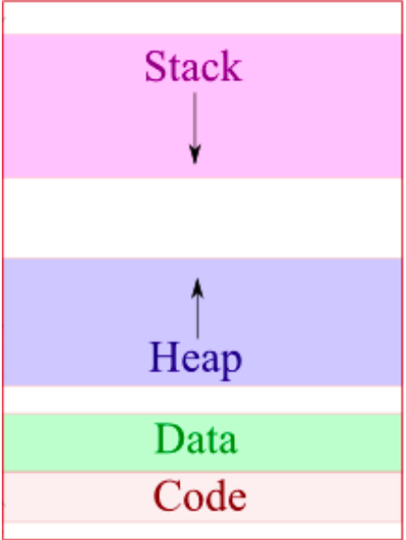
Memory Layout
Let’s revisit this diagram one more time:
Stack – local variables and arguments are stored here
What are the disadvantages of stack allocation?
Data – global and static variables are stored here
What are the disadvantages of the data segment?
Code – our executable code
What if we want memory that is both dynamically allocated and persistent?

Slide 7
The Heap!
Sometimes, we write programs expecting user input or other input from a source we don't control (such as a file)
Accordingly, we may not know the exact number of variables or structs we will need.
In these cases, we utilize the heap.
The heap holds dynamically allocated variables. These are variables whose space is allocated at runtime.
Exactly like creating a new object in Java

Slide 8
Malloc
If we want to dynamically allocate memory, we can use the malloc() function
Malloc takes in one argument: how many bytes to allocate from the heap
It returns a pointer to the allocated memory, or NULL if there’s an error
Example:
int *myInt = malloc(sizeof(int));
Where is myInt stored? Where is *myInt stored?
myInt now points to a block of four bytes on the heap, assuming sizeof(int) == 4

Slide 9
Free
C does not have garbage collection like Java; when we are done with memory, we need to give it back to the heap so that it can be allocated for later use
free() tells C that it can give the memory to other code, which will use it for other purposes
Never use a freed pointer, as this leads to undefined behavior, only free() a block when you’re done with it
What if we forget to free() a block that we allocate?
Example: free(myInt)

Slide 10
Calloc
While malloc() allocates a memory block of given size and returns a pointer to the beginning of the block, malloc() doesn’t initialize the allocated memory—it is garbage data.
If needed, we can use the calloc function to avoid this which will allocate the heap space and initialize it to zero.
Unlike malloc, calloc takes 2 arguments: the number of elements and the size of each element (useful for arrays!)
Example:
int *array = calloc(array_len, sizeof(int))

Slide 11
Realloc
Sometimes, we may wish to grow or shrink the size of a block on the heap. This may or may not actually use the same physical memory block on the heap, but, regardless, we want to preserve the data present
In these cases, we use the realloc function
Example:
int *first5 = realloc(numbers, 5*sizeof(int));
first5 is a pointer to the first 5 ints of the “array” numbers
Note that the pointer numbers is no longer valid

Slide 12
Uses of Malloc
malloc (and friends) are our way of interacting with the heap and gaining access to memory that isn’t on the stack.
Some possible uses of malloc:
Dynamically allocated arrays (1D or multi-dimensional)
Dynamic data structures like linked lists
Large data structures that won’t fit on the stack
When the data needs to survive after the function ends
Stack allocation should be preferred when possible as it is faster

Slide 13
Dynamically Allocated 2D arrays
Let’s say we wish to make a 2D array of ints on the stack.
We can do this very easily: int grid[3][3]
We can also dynamically do this on the heap, like so:
int *grid2 = (int*) malloc(3 * 3 * sizeof(int))
This will create a very similar array to the one above; however, we can’t index it using the standard notation: grid2[row][col]
This is because the compiler doesn’t know that the allocated space is being used as a 2D array
How can we access values in grid2?
Hint: think about the GBA videoBuffer

Slide 14
Lab Assignment: Canvas Quiz
Go to Quizzes on Canvas
Select Lab 15
Password: ramimalloc
Get 100% for lab attendance credit
Unlimited attempts
Collaboration is encouraged!
Ask your TAs for help :)

